Slide 1
Routing

Slide 2
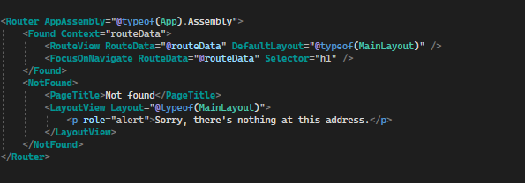
What is Routing
Routing, or navigation, is a fundamental concept when building web applications. Traditionally, moving from one page to another was a case of loading an entirely new, physical HTML page from the server. In more modern server-based frameworks such as MVC or Razor Pages, those pages are dynamically compiled on the server before being sent to the client, but the process is still the same. However, in single-page applications, things work a little differently.
Client-side routing differs substantially from traditional navigation in serverbased web applications. To navigate to another page in traditional multipage apps, a request is made to the server for the new page. The new page is then downloaded to the browser, and the browser renders it. With SPAs, generally speaking, all of the pages reside on the client and navigating between them is handled by a client-side router.
Blazor Router
The router uses reflection to scan for page components. The AppAssembly parameter is used to tell the router where to scan. The Found template is where page components that match a requested route are loaded. The NotFound template is shown when the router can’t find a match for the requested route in its routing table.

Slide 3
When a Blazor app first loads, the Router component uses reflection to scan the application’s assemblies to find routable components, or what I prefer to call page components. These are components that have a special directive declared in them called @page.
The @page directive allows us to specify what route the component will be loaded for. The router then stores the type of the component and the route it handles in a routing table. The router then listens for navigation events via the process described in figure 4.2. When a link is clicked, a navigation event is triggered. Blazor has infrastructure that lives in the JavaScript world, and one of the things that code does is intercept various events, including navigation events.
The URL that the link points to is passed to a JavaScript service called NavigationManager; this service performs several checks to verify that the event should be handled by client-side routing. These checks include ensuring:
Blazor’s router is active.
No modifier keys were pressed, such as Shift or Control, which would signal the user wanted to open the link in a new tab/window.
No target attribute was present on the link. Again, this would signal that the link should be opened in another tab/window.
The only exception to this is a target of _self; this means open in the current tab/window.
The link falls within the scope of the base tag defined in the host page of the Blazor app.
If all these checks pass, then the browser’s history will be updated along with the Uniform Resource Identifier (URI). This enables features such as the browser’s Forward and Back buttons to function and the appearance of traditional full-page navigation. The final step the service takes is to raise an event that triggers some JavaScript interop. This event is picked up by a service with the same name, NavigationManager, that lives in the C# world.
When the C# NavigationManager receives the event, it updates its URI property. This property stores the current URL so components can access it if required. It then triggers an event called LocationChanged. Blazor’s router subscribes to this event, and when it fires, the router checks the URI property of the NavigationManager against its routing table to find a match. If one is found, then the component is loaded; otherwise a NotFound template is rendered

Slide 4
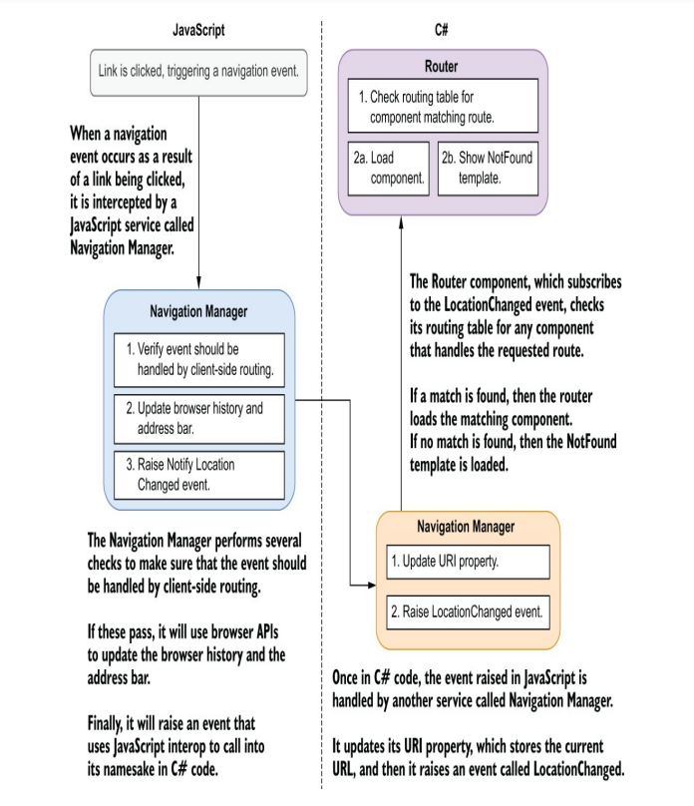

Slide 5
Defining page components
Page components are regular components that declare a specific directive —the @page directive. It has two parts, the directive name and the route template, and when declared looks like this:
@page "/my-awesome-page"
The route template is the section in quotes. This defines the URL that the component will handle—it must always start with a forward slash (/); otherwise you will receive a compiler error. Also, route templates must be unique. Be careful not to declare the same route template on multiple components, as this will result in a run-time error.
It’s perfectly fine to have a single component declare multiple @page directives and handle multiple routes.

Slide 6
Navigating between pages programmatically
One of the first things we learn when building web pages is how to link one page to another using hyperlinks. This method is still a staple of modern SPA applications and works exactly as it would in a traditional server-based app, but there are many scenarios where programmatic navigation is required.
In Blazor, programmatic navigation is achieved via the NavigationManager .NavigateTo() method.

Slide 7
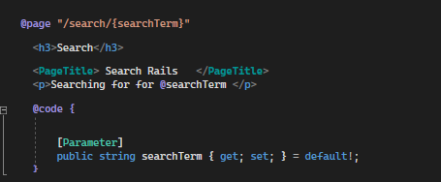
Passing data between pages using route parameters
When navigating between pages, there are times we want to pass arbitrary data as part of the URL.We can do this by using a special feature of route templates called template parameters.
Template parameters are sections of a route that are dynamic, rather than static text. You can think of them in the same way as arguments on a method. They are placeholders for a value that will be supplied later. They are paired with a component parameter that matches the name of the route parameter. When the component is executed, the value in the segment of the route defined by the route parameter is passed into the component parameter so we can access it in code.
We’ve defined the second section of the route template to be a route parameter called SearchTerm. Route parameters are defined inside a route segment by using curly braces ({}); there can be only one per segment. We’ve also declared a component parameter with a name that matches that of the route parameter—the match is case-insensitive. We’ve also initialized the new parameter to its default value and applied the null forgiving operator. This is because it can’t be null. If there is no search term in the URL, then Blazor’s router won’t match the component and it won’t be loaded.

Slide 8

Handling multiple routes with a single component
Handling multiple routes with a single component It’s possible to have a single component be responsible for multiple routes. This can be useful for several reasons—for example, if you’re moving to a new URL structure and you need to support both the old and new versions for a period another advantage is functionality reuse.
Below is an Example:
Where the MaxLength route parameter is defined, there is some additional syntax: :int. This is called a route constraint. Route constraints are important when dealing with route parameters that need to be worked with as a non-string type. By default, all route parameters are considered strings by Blazor. This is a sensible default, as URLs are strings; therefore, values that are passed in the URL must be able to be represented as a string. But in our case, we need to work with MaxLength as an integer in our code.
We can tell Blazor that the value in that route parameter must be converted to an integer by using the :int route constraint. Once a route constraint has been applied, it becomes part of the checks Blazor performs to match a route.
For a full list of all route constraints supported by the framework, you can check the following page on the official docs (http://mng.bz/d2xg).

Slide 9
Working with query strings
Query strings have been an integral part of web applications since the early days of web development. A query string is an instance or collection of key value pairs at the end of a URL. An example query string looks like this: www.blazor.net?blazor=awesome
The query string starts with a question mark (?), then comes the key-value pair separated by an equals sign (=). Query strings can be a good option when you want to work with multiple optional values.
However, with .NET 6, two important features were added that make working with query strings a breeze: the SupplyParameterFromQuery attribute and the query-string helper methods on NavigationManager. We will use these features to help improve the design of our trail search filters.

Slide 10
We use the GetUriWithQueryParameters method to construct a new URI containing a query string. There are two overloads of this method. The one we’re using will return the current URI with the supplied key-value pairs attached as a query string. The other overload takes two arguments, a URI and a dictionary. It returns a new URI using the supplied URI as the base with the query string attached.
There is also a singular version of this method available called GetUriWithQueryParameter. This method takes a name and a value and returns the current URI with the supplied name and value as a query string.
The GetUriWithQueryParameters method takes a dictionary, and depending on the value of a key, it will include or omit that value from the query string.

Slide 11
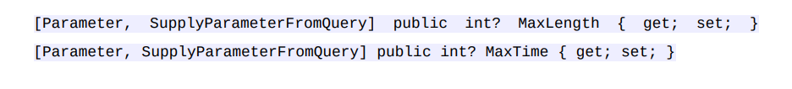
Retrieving query-string values using SupplyParameterFromQuery
Well, we’re going to use parameters decorated with a special attribute called SupplyParameterFromQuery. When we create a parameter on a component and add this attribute, Blazor will attempt to set the value of the property based on a query string with a matching name. This is why using the nameof() technique is so useful: it ensures that the key name used in the query string always matches that of the destination parameter.
Note that we’re still including the Parameter attribute. The SupplyParameterFromQuery attribute works with the Parameter attribute. If both aren’t added, the property won’t be set

Slide 12
Summary
Navigation in Blazor is handled by a client-side router, which is a component.
By default, the router component resides in the App component at the top of the app component tree.
Pages in Blazor are just components that contain a special directive called @page.
It is possible to define multiple page directives on a single component and have it load for more than one route.
The page directive requires a route to be defined, which the component will handle.
Reflection is used by the router to find pages; these are then stored in a table in memory by the router.
When a route is requested, the router looks up which component handles the requested route.

Slide 13
If a match for the route isn’t found, then the markup defined in the router’s NotFound template is displayed.
Developers can trigger navigation programmatically using the NavigationManager service.
The NavigationManager class exposes an event called LocationChanged, which is triggered whenever a navigation occurs.This can be subscribed to by developers to run custom actions.
Simple data, such as IDs, can be passed between pages via route parameters.
Route parameters are strings by default, and route constraints must be used if the developer wants to work with them as a different type; for example an int.
Query string parameters can be added to the URL via the GetUriWithQueryParameters or GetUriWithQueryParameter methods available on the NavigationManager class.
Page components can access query-string parameters in the URL by defining parameters that match the name of each query parameter, decorated with the SupplyParameterFromQuery attribute.

